Slide 1


Artificial Intelligence (Machine Learning & Deep Learning)
NAVTCC & Strings Technologies
by Salman Ahmad

Slide 2
Outline
Brief introduction to the program
1
2
Course objectives
Intended learning outcomes
3
4
Course Structure
How to Get the Most Out of Training
5
6
Trainer Introduction
7
Expectations & Code of Conduct
6

Slide 3

Program Objectives
Provide in-depth knowledge
Natural Language Processing (NLP)
Artificial Intelliegence, Machine Learning, Deep Learning
Tools, Techniques and use cases for NLP
Hands-on implementation
Microsoft Azure AI Services
Python, TensorFlow, PyTorch
For AI deployment on the cloud

Slide 4
Intended Learning Outcomes
1
Understanding Core AI & ML Concepts
Implement machine learning models
3
Work with scikit-learn, pandas, NumPy, TensorFlow, PyTorch Core AI & ML Concepts
2
4
Gain expertise in data preprocessing and model evaluation
Develop NLP models
5
5
Learn Microsoft Azure AI solutions

Slide 5



The Journey Ahead
Duration : 3 Months
Class Hours : 4 hr
Theory Vs Practical: 20/80

Slide 6
The Journey Ahead
Python & Linux Fundamentals
1
2
Exploratory Data Analysis
Machine Learning
3
4
Deep Learning
NLP & AI Model Deployment
5
6
Microsoft Azure AI Services

Slide 7






How to get the most out of this course?
Be Curious & Ask Questions
Practice Consistently
Follow Best Practices
Work on Real-World Problems
Engage in Peer Learning

Slide 8

Statistica: AI market World-wide Vs Pakistan
 | World-wide | Pakistan
Market size by 2025 | US$243.72bn | US$949.17m
Annual growth rate | 27.67% | 27.76%
Market size by 2030 | US$826.73bn | US$3.23bn
Market size is the total potential revenue or customers in a specific industry.

Slide 9
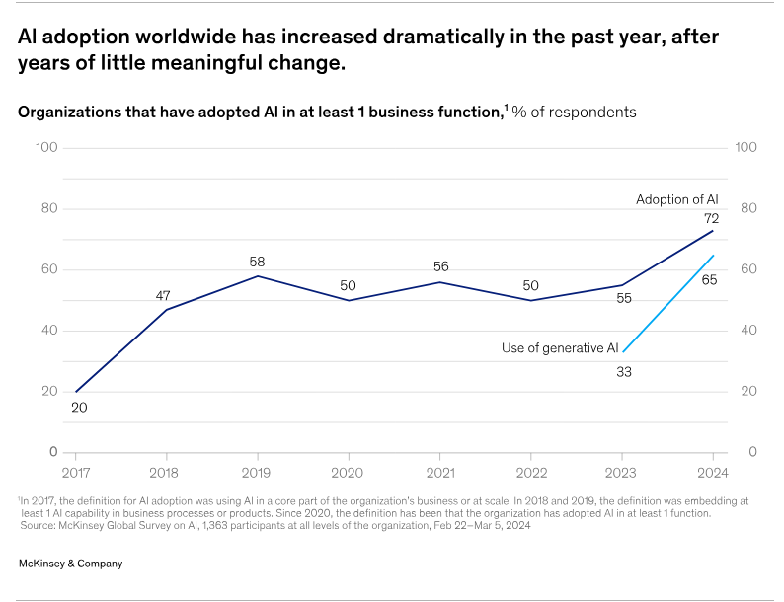
McKinsey Global Survey Gen AI 2024
source: mckinsey.com/capabilities/quantumblack/our-insights/the-state-of-ai

Slide 10
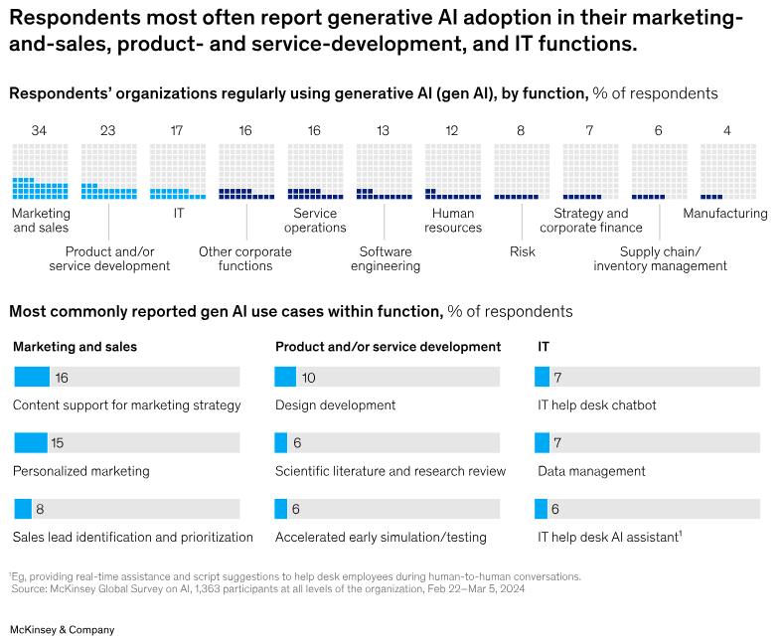
McKinsey Global Survey Gen AI 2024
source: mckinsey.com/capabilities/quantumblack/our-insights/the-state-of-ai

Slide 11
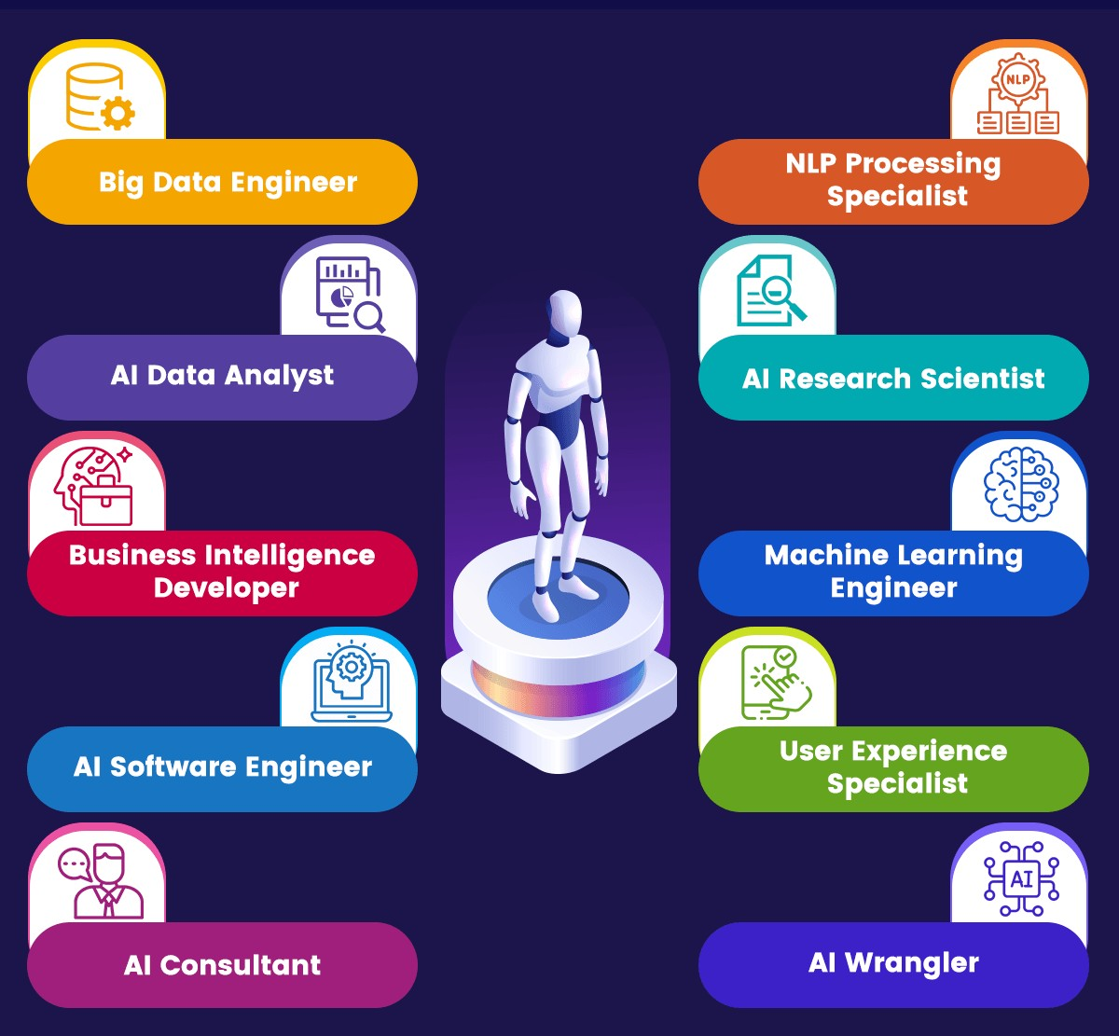
AI Careers: Shaping Pakistan's Future
source: 101blockchains

Slide 12


Career Opputunities
Companies hiring AI professionals:
1
Careem
2
Afinit
3
NetSol
4
ArbiSoft
5
i2c
6
Crossover

Slide 13

Your Trainer: Your Guide to AI Mastery
I’d love to introduce myself as the hero of this story… but the truth is, I’m just another learner, figuring things out one line of code at a time.

Slide 14

Questions?
"He who asks a question is a fool for a minute; he who does not remains a fool forever." – Confucius

Slide 15
Lab Tasks
Software Installation (Anaconda, VSCode)
Download Anaconda: https://www.anaconda.com/download/success
Install Anaconda
Download Visual Studio Code: https://code.visualstudio.com/download
Install VSCode
Test Installations

